Slide 1
iFlow
Derrick Adkins
Colin Malott
Jared Weeks

Slide 2
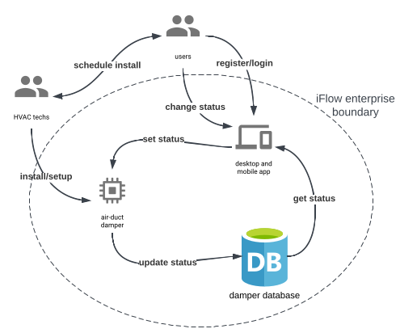
First vision
Users communicate with HVAC techs to schedule installation
User registers an account and signs into the app.
HVAC technician installs dampers in the air-ducts and walks user through setup in the app.
User is then able to check and update damper statuses.

Slide 3
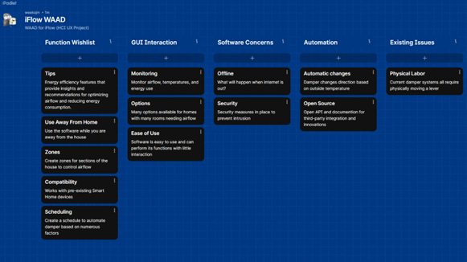
Understanding needs
Remote Use
Grouping
Smart-home integration
Schedules
Reporting

Slide 4
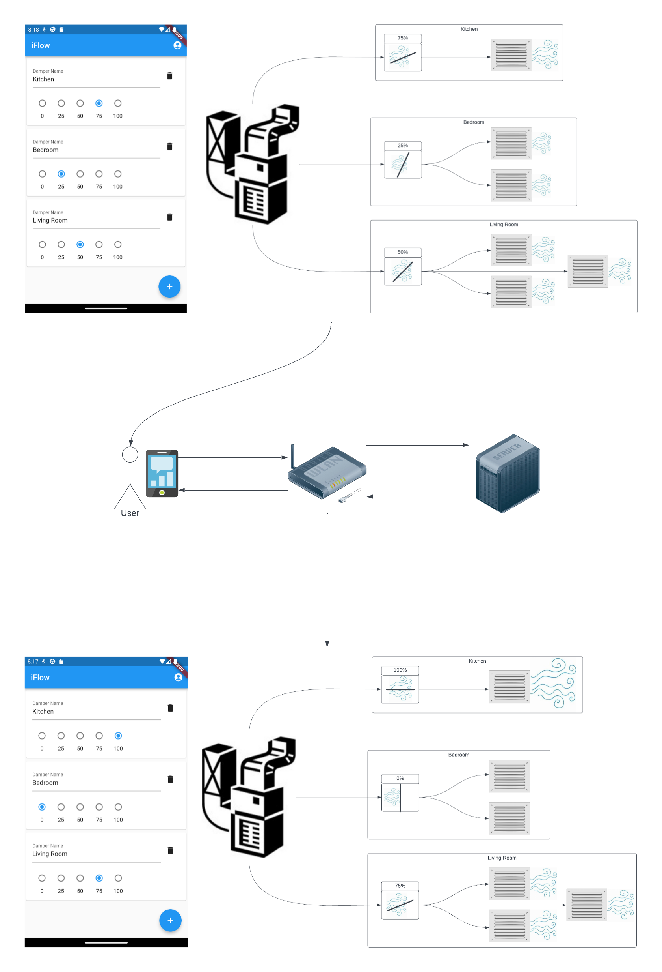
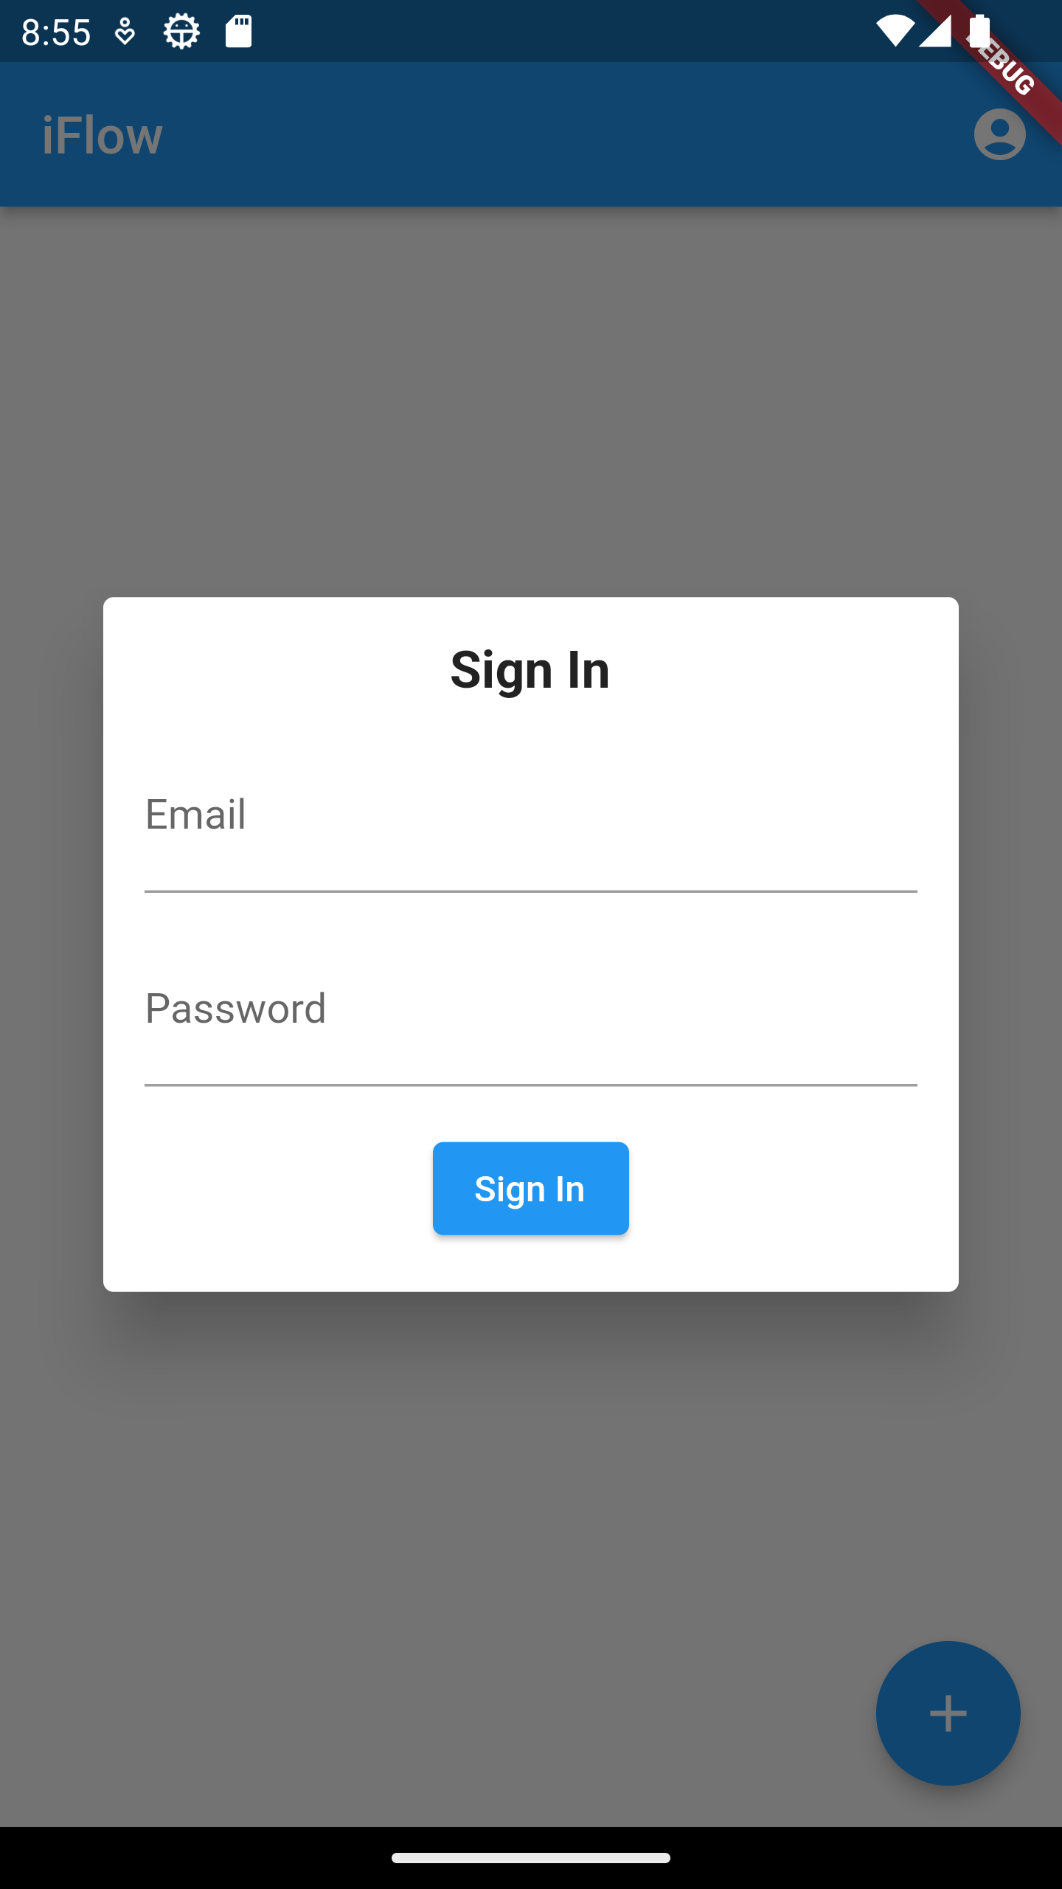
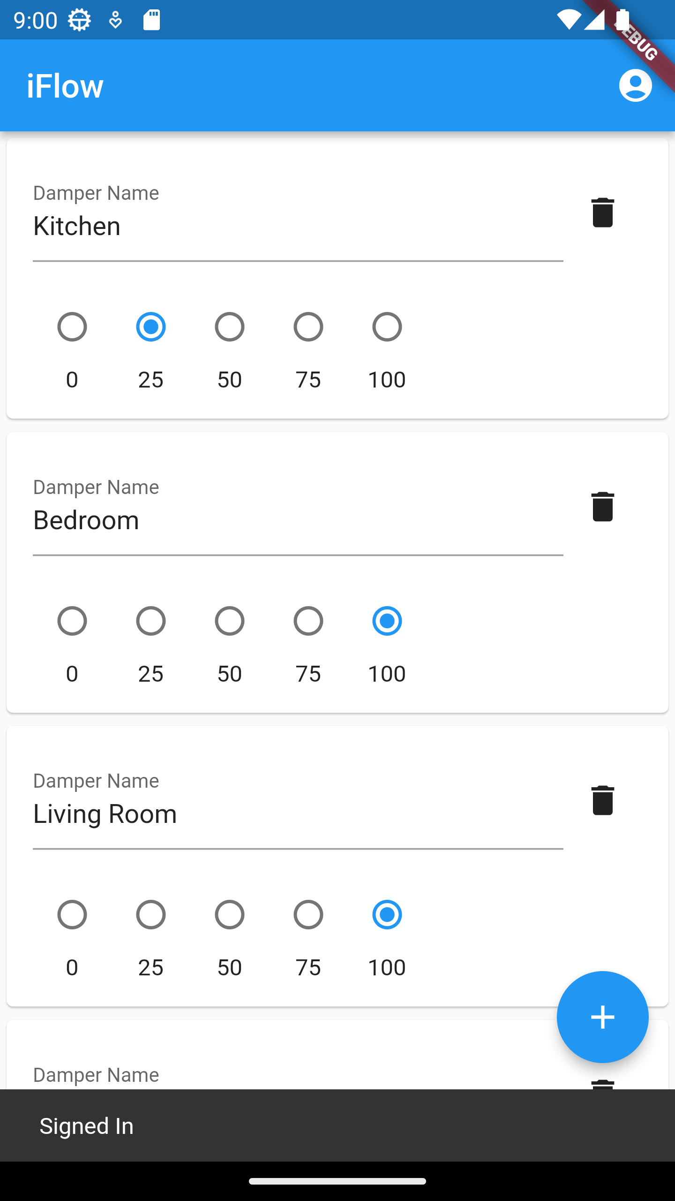
Design solutions

Slide 5
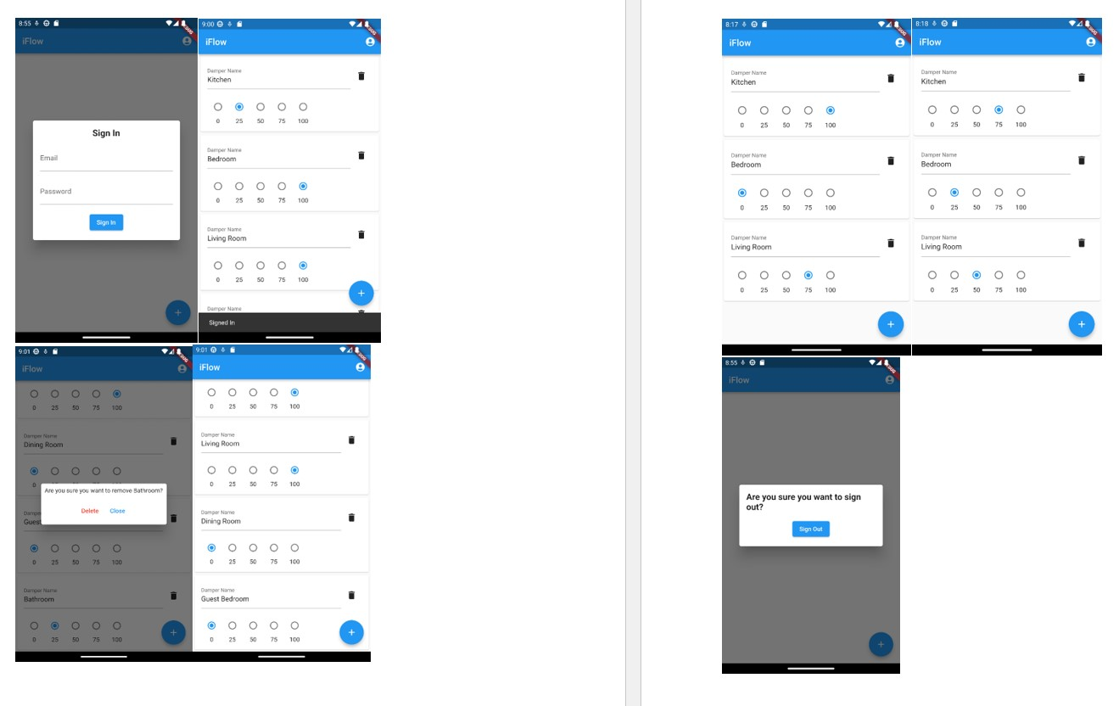
Prototype candidates
Streamlined the Design Solutions
Enhanced visual cues and design elements
Layout and Functionality
Needs and Expectations

Slide 6
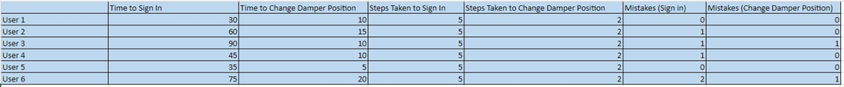
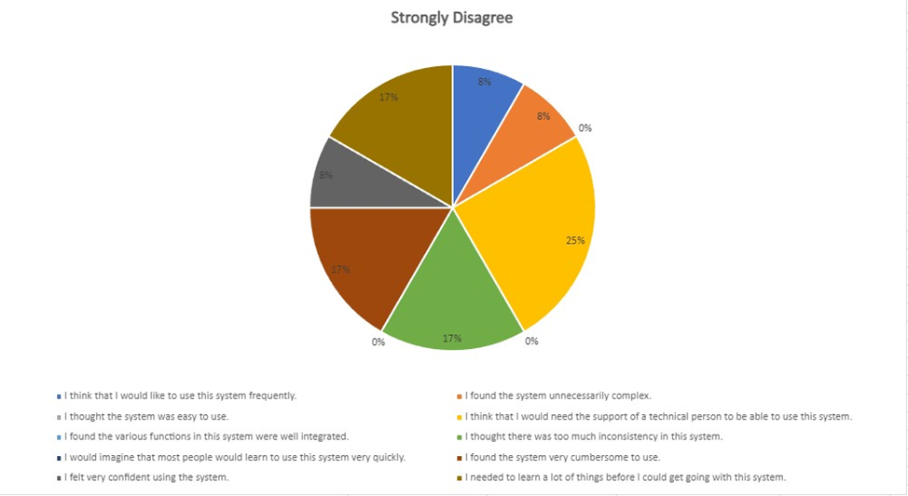
Evaluate ux
Quantitative Data
Objective: Overall experience with the app
Quantitative Data: How each user follows the steps
Qualitative Data: Feedback about the accessibility
Reworks: Sign-In and Interface Design
Qualitative Data

Slide 7

What was learned
After applying the Lifecycle, we now understand the importance of the Human Control Interaction of User Experience
While the Prototype phase gave us a sense of real-world interaction, it was the Evaluation phase that made our app more of a reality.
Moving forward with the app

Slide 8
Changes during the UX Life Cycle
Minimal changes through most of the life cycle
Most changes occurred after the Evaluation stage
Feedback helped us fine-tune design to customer’s needs

Slide 9
Personal Learnings about UX
Team had varying levels of understanding
Onboarding is an important feature to nail down
Accessibility is key
Testing is a must

